Slide 1
4158 cd
202020179 최유진

Slide 2
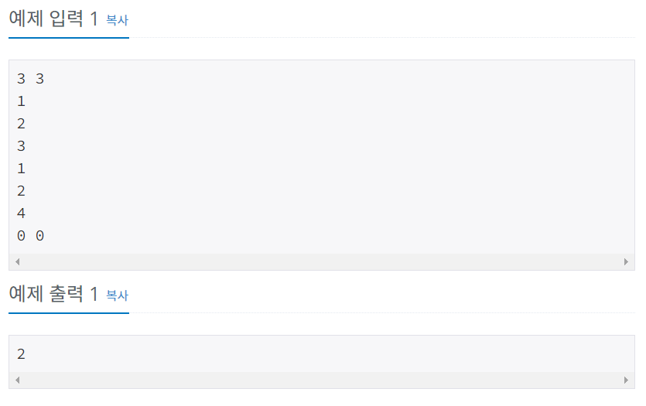
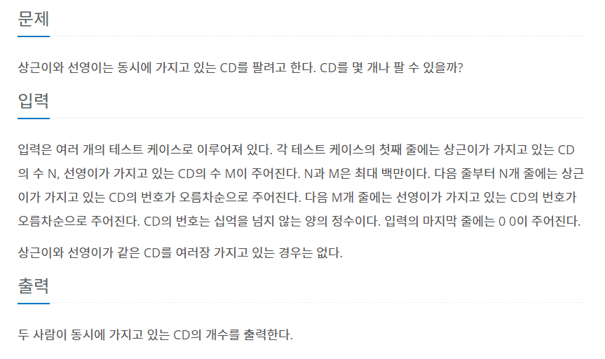

Slide 3
import sys
input=sys.stdin.readline
while True:
n,m=map(int,input().split())
if n==0 and m==0:
break
cd1=[]
cd2=[]
for i in range(n):
cd1.append(int(input()))
for j in range(m):
cd2.append(int(input()))
test=list(set(cd1)&set(cd2))
print(len(test))

Slide 4
import sys
input=sys.stdin.readline
while True:
n,m=map(int,input().split())
if n==0 and m==0:
break
cd1=[]
cd2=[]
for i in range(n):
cd1.append(int(input()))
for j in range(m):
cd2.append(int(input()))
test=list(set(cd1)&set(cd2))
print(len(test))

Slide 5
2512 예산
202020179 최유진

Slide 6
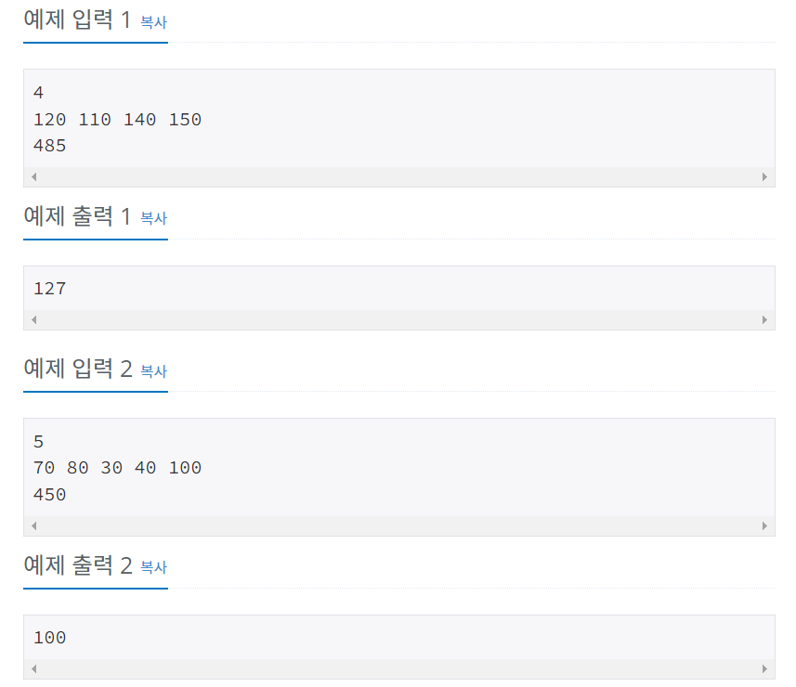
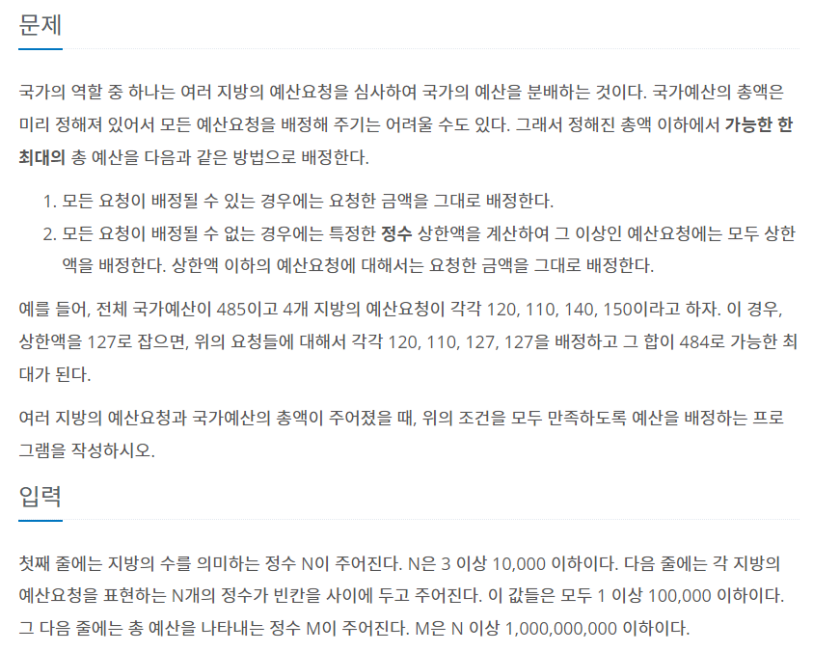

Slide 7
import sys
input=sys.stdin.readline
n=int(input())
money=[]
money=list(map(int,input().split()))
max_m=int(input())
#print(sum(money))
if sum(money)<max_m:
print(max(money))
else:
s=0
e=max(money)
while s<=e:
sum_result=0
mid=(s+e)//2
for i in money:
if i>=mid:
sum_result+=mid
else:
sum_result+=i
if sum_result<=max_m:
s=mid+1
else:
e=mid-1
print(e)

